Slide 1
CS 3813: Introduction to Formal Languages and Automata
Chapter 2
Deterministic finite automata
These class notes are based on material from our textbook, An Introduction to Formal Languages and Automata, 3rd ed., by Peter Linz, published by Jones and Bartlett Publishers, Inc., Sudbury, MA, 2001. They are intended for classroom use only and are not a substitute for reading the textbook.

Slide 2
Review of set notation
for formal languages
w^{n} denotes string obtained by concatenating w n times
w⁰ = λ
{a,b}* denotes all strings over the alphabet {a,b}

Slide 3
Finite automaton
a
b
a
q₀
q₁
q₂
q₃
Finite-state controller
Reading head
a
b
a
a
end
Finite tape with input string.
The tape is read from left to right; no going back.

Slide 4
Deterministic Finite Accepter
Defined by a quintuple: M = (Q, Σ, δ, q₀, F)
Q is a finite, nonempty set of states
Σ is finite set of input symbols called alphabet
δ: Q × Σ → Q is the transition function
q₀ ∈ Q is the initial state
F ⊆ Q is a set of final or “accepting” states
In a deterministic finite automaton (DFA), each transition is completely determined by the current state and current input symbol

Slide 5
Deterministic Finite Accepter
Example:
M = ({q₀, q₁, q₂}, {a,b}, δ, q₀, {q₁})
Q = {q₀, q₁, q₂}
Σ = {a,b}
δ is the transition function (see next slide)
q₀ is the initial state
{q₁} is the set of final states
In a deterministic finite automaton (DFA), each transition is completely determined by the current state and current input symbol

Slide 6
Transition table
The transition function of a finite automaton can be represented by a table:
state input next state
q₀ a q₀
q₀ b q₁
q₁ a q₂
q₁ b q₂
q₂ a q₂
q₂ b q₂
For a DFA, δ is a total function; that is, there is one and only one entry for each combination of state and input symbol.
The transition function can be regarded as a “program.”

Slide 7
State transition diagram
A DFA can be represented by a (state) transition diagram:
a
a,b
q₀
b
q₁
a,b
q₂
In this DFA, q₀ is the initial state, q₁ is a final state,
and q₂ is a “trap state” (because once entered, it is
impossible to leave it).
What language does this finite automaton accept?

Slide 8
State transition table
Every DFA also can be represented by a state transition table:
 | a | b
q₀ | q₀ | q₁
q₁ | q₂ | q₂
q₂ | q₂ | q₂
→

Slide 9
Configuration of a DFA
A configuration summarizes the information about
past inputs that is needed to determine the behavior
of the automaton on subsequent inputs:
the current state
the contents of the tape that have not been read, that is, that are to the right of the read/write head
notation: (q₃, aba)
Current state
Contents of tape that have not been read yet

Slide 10
“Yields” relation
Indicates a transition from one configuration of a DFA to the next configuration, which is equivalent to one step in a computation
notation: (q₀, abba) |= (q₁,bba)
|=^{n} denotes a transition from one configuration of a DFA to another after n steps
|=* denotes the reflexive, transitive closure of the relation |=, i.e., it denotes a transition from one configuration of a DFA to another after zero or more steps

Slide 11
Extended transition function
The extended transition function is represented by:
δ* : Q × Σ* → Q
The Σ* denotes a string instead of a single character
Q will represent the state the automaton will be in after reading the entire string instead of a single character

Slide 12
Extended transition function
Given:
a
b
c
q₀
q₁
q₂
q₃
What is δ* (q₀, abc) ?

Slide 13
Extended transition function
Let M = (Q, Σ, q₀, δ, A) be an FA. We can define the function δ∗ : Q × Σ ∗ → Q as follows:
For any q ∈ Q, δ∗ (q, λ) = q
For any y ∈ Σ ∗ , a ∈ Σ, and q ∈ Q,
δ∗ (q, ya) = δ (δ∗ (q, y) , a)

Slide 14
Computation
Since a DFA is an abstract model of computation, we can now define mathematically what we mean by “computation”
A computation is a sequence of transitions from one configuration to another
A computation proceeds according to a finite set of rules or instructions -- the transition function (or program) of the DFA

Slide 15
Mnemonic labels for states
We don’t have to label our states with q_{subscript}. We can give them mnenonic labels that remind us of how we got to that particular state. This can help us decide how to build an automaton. For example, let’s find a DFA that accepts all strings on {0, 1} except those containing the string 001.

Slide 16
Mnemonic labels for states
The string λ is accepted by this DFA, so the start state must be an accepting state. Let’s label it λ.
If our string starts off 001, it must be rejected. So we know that there must be a consecutive path from the start state to a trap state via three arcs labeled 0, 0, and 1. Let’s label that state 001.
We can see that along this path there must be two other states labeled 0 and 00. Strings ending in 0 are accepted, so these are accepting states.
So far we have:
0
0
1
λ
0
00
001

Slide 17
Mnemonic labels for states
At state λ, if we see a 0, we start counting 0’s. If we see a 1, we loop back to the same state. Strings ending here are accepted.
At state 0, we have seen one 0 already. If we see a second 0, we need to move to state 00. If we see a 1, we have to go back to the beginning and start counting the number of consecutive 0’s we have seen. Strings ending here are accepted.
Once we are at state 00, we move to the trap state if we see a 1. As long as the string ends here, it is accepted. So loop on a 0.
0
0
1
λ
0
00
001
1
1
0
0,1

Slide 18
The language accepted by a DFA
The language accepted by a DFA M is denoted L(M)
It is the the set of all strings such that, when M starts in its initial configuration, it ends up in an accepting configuration.

Slide 19
Accepting
Let M = (Q, Σ, q₀, δ, F) be an FA.
A string w ∈ Σ∗ is accepted by M if
δ∗(q₀, w) ∈ F
The language accepted (or recognized) by M is the set of all strings on Σ that are accepted by M
Formally:
L(M) = {w ∈ Σ* : δ* (q₀, w) ∈ F}

Slide 20
Rejecting
Here is a DFA that accepts any string:
q₀
(anything)
The power of a machine lies in its ability to discriminate - to accept only some strings as belonging to a language, and to reject all others.

Slide 21
Regular languages
A language L over the alphabet Σ is regular iff (if and only if) there is a Deterministic Finite Automaton that accepts L.

Slide 22
Regular languages
Show that the language
L = {awa : w ∈ {a,b}*}
is regular.
To do this, all we have to do is construct a DFA that accepts this language

Slide 23
L = {awa : w ∈ {a,b}*}
a
a
q₀
q₁
q₂
b
a,b
q₃
This finite accepter accepts all and only the strings of the language given above. But note that there are two arcs out of q₁ labeled a. How does the FA know which path to take on an a? It doesn’t; it has to magically guess right. Also, there are no arcs out of q₂. So this FA is nondeterministic.

Slide 24
Nondeterminism
A finite automaton is deterministic if:
from every node there is exactly one arc labeled for each character in the alphabet of the language

Slide 25
L = {awa : w ∈ {a,b}*}
b
a
q₀
q₁
q₂
a
b
b
a
q₃
a,b
This is a deterministic version of the previous automaton; there is exactly one arc out of each state labeled with each symbol from Σ.

Slide 26
L = {awa : w ∈ {a,b}*}
b
a
q₀
q₁
b
a
b
q₃
q₂
a
a, b
This is the same DFA. It is just drawn differently.

Slide 27
Nondeterministic finite accepters
Actually, any nondeterministic FA can be turned into a deterministic FA. That is why this class of automata is called Deterministic Finite Accepters.

Slide 28
Deterministic finite accepters
L = {a^{m}b^{n} : m, n ≥ 0}
Give a DFA that accepts this language

Slide 29
L = {a^{m}b^{n} : m, n ≥ 0}
What do we know about this language’s automaton?
Will it accept the empty string? If so, how do we represent that?
Will it accept strings that begin with an a?
Having begun with an a, seeing indefinitely many more a’s are OK ; the automaton can loop here.
Will it accept strings that begin with a b?
Once it sees a b, the automaton now has to be on guard.
As long as it continues to see b’s , it’s OK; loop.
If the string ends here, accept.
If it sees an a after seeing a b, reject.

Slide 30
L = {a^{m}b^{n} : m, n ≥ 0}
a
b
a
q₀
q₁
q₂
q₃
b
a
b
q₄
Does this automaton correspond to (represent, accept) the above language?
(Be careful!)

Slide 31
L = {a^{m}b^{n} : m, n ≥ 0}
a
b
a
q₀
q₁
q₂
b
a,b
Does this automaton correspond to (represent, accept) the above language? Is it deterministic?

Slide 32
Some exercises
a
b
a,b
b
a
q₀
q₁
q₂
Use set notation to describe the language accepted by the above DFA

Slide 33
Some exercises
a
b
a,b
b
a
q₀
q₁
q₂
L(M) = {a^{n}b^{m}}, where n ≥ 0 and m ≥ 1

Slide 34
Some exercises
Give a DFA that accepts the formal
language {ab}.

Slide 35
Some exercises
A DFA that accepts the formal language {ab}.
a
b
q₀
q₁
q₂
b
a
a,b
q₃
a,b

Slide 36
Some exercises
Use set notation to describe the language
accepted by the following DFA.
b
a
b
c
c
a
b,c
a
a,b,c
Can you give a DFA that accepts the
complement of this language?

Slide 37
NDFA
An NDFA can be non-deterministic by:
having more than one edge with the same label originate from one vertex: see state q₁, which has two arcs labeled 0 emanating from it
having states without an edge originating from it for some symbol: see state q₂, which has no edges labeled 0 or 1. (This may be interpreted as a transition to the empty set.)
having lambda-transitions: see state q₀, which has an arc indicating that a λ-move from q₀ to q₂ is possible
1
0,1
q₀
q₁
q₂
0
λ

Slide 38
NDFA
A non-deterministic finite accepter (abbreviated NFA or NDFA) is defined by the quintuple:M = (Q, Σ, δ, q₀, F)
Q is a finite, nonempty set of states
Σ is finite set of input symbols called alphabet
δ: Q × (Σ ∪ {λ}) → 2^{Q} is the transition function
q₀ ∈ Q is the initial state
F ⊆ Q is a set of final or “accepting” states

Slide 39
NDFA
Differences between a DFA and an NDFA:
(1) in an NDFA, the range of δ is in the powerset of Q (instead of just Q), so that from the current state, upon reading a symbol:
(a) more than one state might be the next state of the NDFA, or
(b) no state may be defined as the next state of the NDFA, and
(2) λ-moves are possible; that is, a transition from one state to another may occur without reading a symbol from the input string.

Slide 40
NDFA
The extended transition function for an NDFA is defined so that δ* (q_{i}, w) contains q_{j} iff there is a walk in the transition graph from q_{i} to q_{j} labeled w.
The language L accepted by an NDFA
M = (Q, Σ, δ, q₀, F) is defined as
L(M) = {w ∈ Σ* : δ* (q₀, w) ∩ F ≠ ∅}
That is, the language consists of all strings w for which there is a walk labeled w from the start state to a final state in the transition graph.

Slide 41
NDFA = DFA
One kind of automaton is more powerful than another if it can accept and reject some kinds of languages that the other cannot.
Two finite accepters are equivalent if both accept the same language, that is,
L(M₁) = L(M₂)
As mentioned previously, we can always find an equivalent DFA for any given NDFA.
Therefore, NDFA’s are no more powerful than DFA’s.

Slide 42
NDFA → DFA
Theorem 2.2 in Linz:
Let L be the language accepted by a non-deterministic finite accepter M_{N} = (Q_{N}, Σ, δ_{N}, q₀, F_{N}) . Then there exists a deterministic finite accepter M_{D} = (Q_{D}, Σ, δ_{D}, {q₀}, F_{D}) such that L = L(M_{D}).
Proof by construction.

Slide 43
NDFA → DFA
Create a graph G_{D} with vertex {q₀}. Identify this vertex as the initial vertex.
Repeat the following steps until no more edges are missing:
  Take any vertex {q_{i}, q_{j}, …, q_{k}} of G_{D} that has no outgoing edge for some a ∈ Σ.
  Compute δ* (q_{i}, a), δ* (q_{j}, a), …, δ* (q_{k}, a).
  The form the union of all these δ*, yielding the set {q_{l}, q_{m}, …, q_{n}}.
  Create a vertex for G_{D} labeled {q_{l}, q_{m}, …, q_{n}} if it does not already exist.
  Add to G_{D} an edge from {q_{i}, q_{j}, …, q_{k}} to {q_{l}, q_{m}, …, q_{n}} and label it with a.
Every state of G_{D} whose label contains and q_{f} ∈ F_{N} is identified as a final vertex.
If M_{N} accepts λ, the vertex q₀ in G_{D} is also made a final vertex.

Slide 44
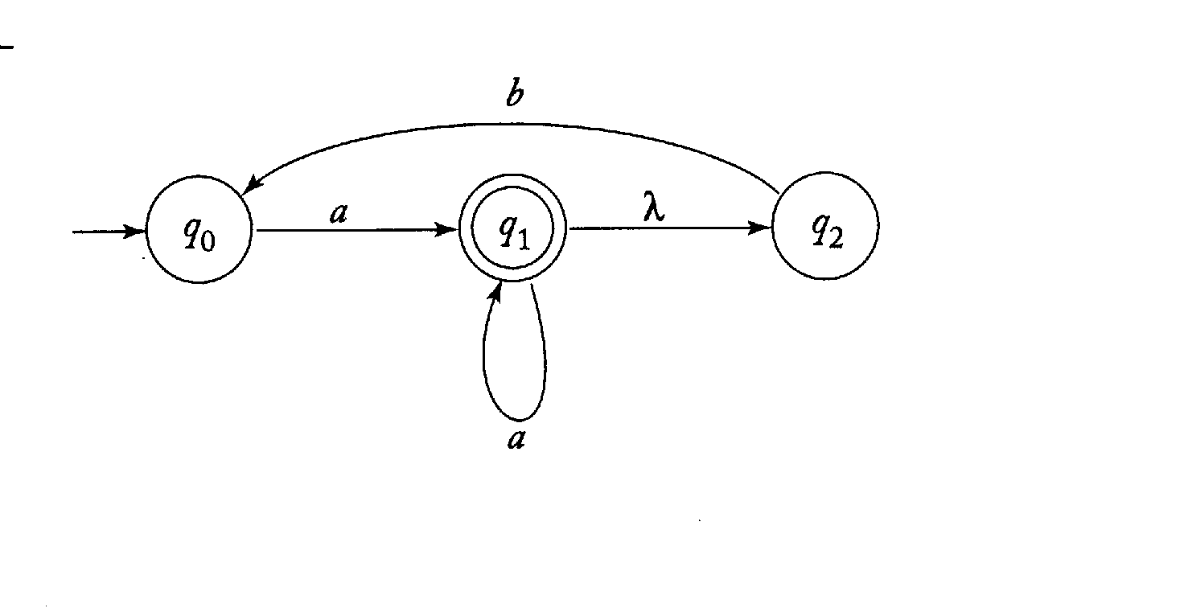
NDFA → DFA
Example: Convert the following NDFA into an equivalent DFA (Figure 2.12 in Linz.).

Slide 45
NDFA → DFA
Create a graph G_{D} with vertex {q₀}. Identify this vertex as the initial vertex.
OK; here it is:
{q₀}

Slide 46
NDFA → DFA
Repeat the following steps until no more edges are missing:
  Take any vertex {q_{i}, q_{j}, …, q_{k}} of G_{D} that has no outgoing edge for some a ∈ Σ.
  OK. Vertex q₀ in our new DFA has no outgoing edge for a yet.
  Compute δ* (q_{i}, a), δ* (q_{j}, a), …, δ* (q_{k}, a).
  OK. From q₀ in our NDFA, upon reading an a the extended transition function leaves us in state q₁, or q₂ via a “free” lambda-move.

Slide 47
NDFA → DFA
  Then form the union of all these δ*, yielding the set {q_{l}, q_{m}, …, q_{n}}.
  So our new DFA will have a state labeled {q1, q2}.
  Create a vertex for G_{D} labeled {q_{l}, q_{m}, …, q_{n}} if it does not already exist.
  So create a vertex for our new DFA and label it {q1, q2}.
  Add to G_{D} an edge from {q_{i}, q_{j}, …, q_{k}} to {q_{l}, q_{m}, …, q_{n}} and label it with a.
  So add a transition labeled a to {q1, q2} from q₀.

Slide 48
NDFA → DFA
So now we have:
{q₀}
{q₁, q₂}
a

Slide 49
NDFA → DFA
Repeat the following steps until no more edges are missing:
  Take any vertex {q_{i}, q_{j}, …, q_{k}} of G_{D} that has no outgoing edge for some a ∈ Σ.
  OK. Vertex q₀ in our new DFA has no outgoing edge for b yet.
  Compute δ* (q_{i}, b), δ* (q_{j}, b), …, δ* (q_{k}, b).
  Well, there is no transition specified in our NDFA from state q₀ upon reading a b. Therefore, δ* ({q₀}, b) = ∅.

Slide 50
NDFA → DFA
  Then form the union of all these δ*, yielding the set {q_{l}, q_{m}, …, q_{n}}.
  So our new DFA will have a state labeled ∅.
  Create a vertex for G_{D} labeled {q_{l}, q_{m}, …, q_{n}} if it does not already exist.
  So create a vertex for our new DFA and label it ∅.
  Add to G_{D} an edge from {q_{i}, q_{j}, …, q_{k}} to {q_{l}, q_{m}, …, q_{n}} and label it with a.
  So add a transition labeled b to ∅ from q₀.

Slide 51
NDFA → DFA
So now we have:
{q₀}
{q₁, q₂}
b
a
∅
Any state labeled ∅ represents an impossible move and thus is a non-final trap state.
a, b

Slide 52
NDFA → DFA
Repeat the following steps until no more edges are missing:
  Take any vertex {q_{i}, q_{j}, …, q_{k}} of G_{D} that has no outgoing edge for some a ∈ Σ.
  OK. Vertex {q₁, q₂} in our new DFA has no outgoing edge for a yet.
  Compute δ* (q_{i}, b), δ* (q_{j}, b), …, δ* (q_{k}, b).
  OK. From q₁ in our NDFA, upon reading an a the extended transition function leaves us in state q₁, or q₂ via a “free” lambda-move. From q₂ in our NDFA, upon reading an a there is no specified transition.

Slide 53
NDFA → DFA
  Then form the union of all these δ*, yielding the set {q_{l}, q_{m}, …, q_{n}}.
  The union is {q₁, q₂} .
  Create a vertex for G_{D} labeled {q_{l}, q_{m}, …, q_{n}} if it does not already exist.
  It does.
  Add to G_{D} an edge from {q_{i}, q_{j}, …, q_{k}} to {q_{l}, q_{m}, …, q_{n}} and label it with a.
  So add a transition labeled a to {q₁, q₂} from {q₁, q₂} .

Slide 54
NDFA → DFA
So now we have:
a
{q₀}
{q₁, q₂}
b
a
∅
a, b

Slide 55
NDFA → DFA
Repeat the following steps until no more edges are missing:
  Take any vertex {q_{i}, q_{j}, …, q_{k}} of G_{D} that has no outgoing edge for some a ∈ Σ.
  OK. Vertex {q₁, q₂} in our new DFA has no outgoing edge for b yet.
  Compute δ* (q_{i}, b), δ* (q_{j}, b), …, δ* (q_{k}, b).
  OK. From q₂ in our NDFA, upon reading a b the extended transition function leaves us in state q₀. From q₁ in our NDFA, upon reading a b there is no specified transition. However, we can make a free lambda-move to q₂, and thence to q₀.

Slide 56
NDFA → DFA
  Then form the union of all these δ*, yielding the set {q_{l}, q_{m}, …, q_{n}}.
  The union is {q₁, q₂} .
  Create a vertex for G_{D} labeled {q_{l}, q_{m}, …, q_{n}} if it does not already exist.
  It does.
  Add to G_{D} an edge from {q_{i}, q_{j}, …, q_{k}} to {q_{l}, q_{m}, …, q_{n}} and label it with a.
  So add a transition labeled b to q₀ from {q₁, q₂} .

Slide 57
NDFA → DFA
Exit from loop.
Every state of G_{D} whose label contains and q_{f} ∈ F_{N} is identified as a final vertex.
OK. State q1 in the NDFA is a final state, so state {q1, q2} in the DFA will be a final state.
If M_{N} accepts λ, the vertex q₀ in G_{D} is also made a final vertex.
It doesn’t. We’re through!

Slide 58
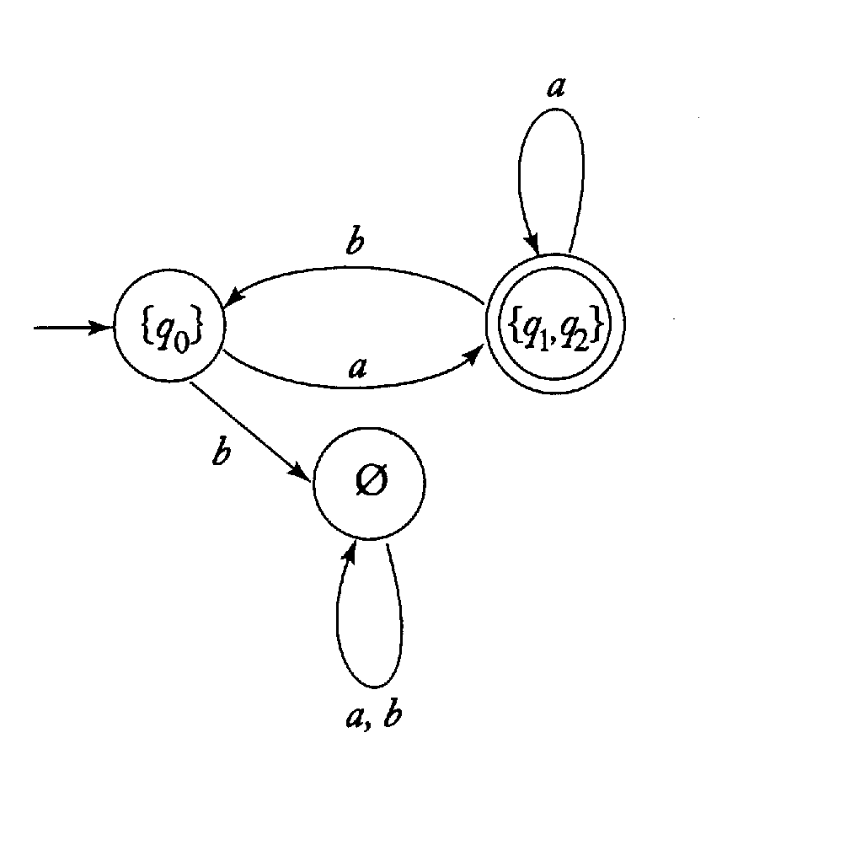
NDFA → DFA
Here is the finished DFA (Figure 2.13 in Linz):

Slide 59
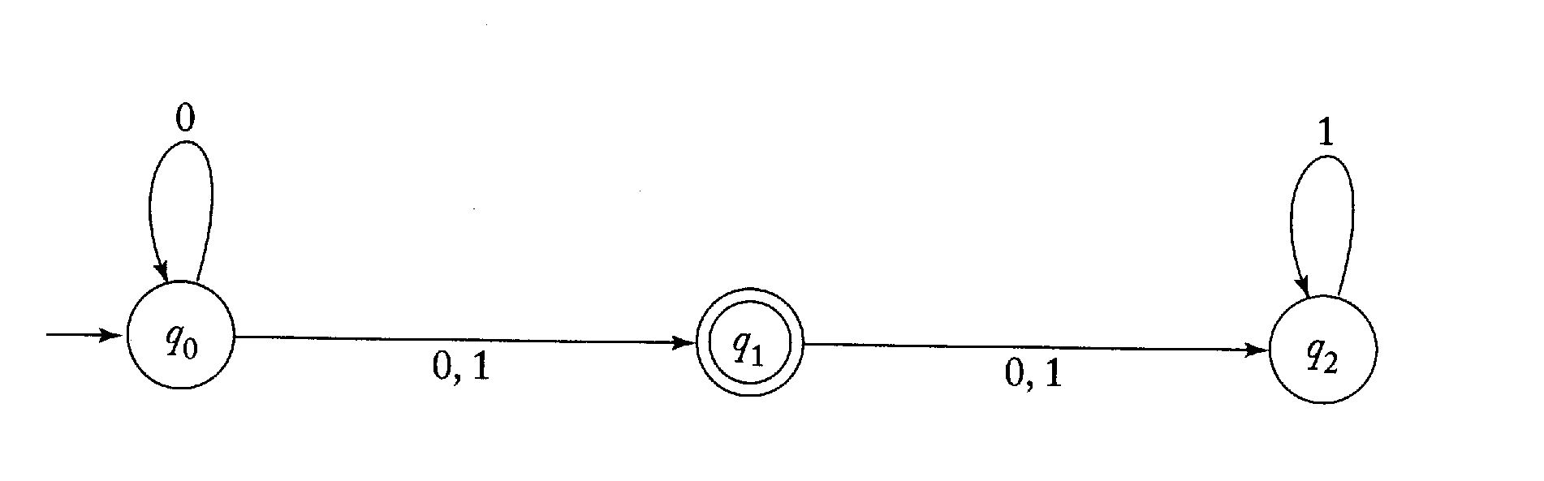
NDFA → DFA
Example: Convert this NDFA to a DFA.

Slide 60
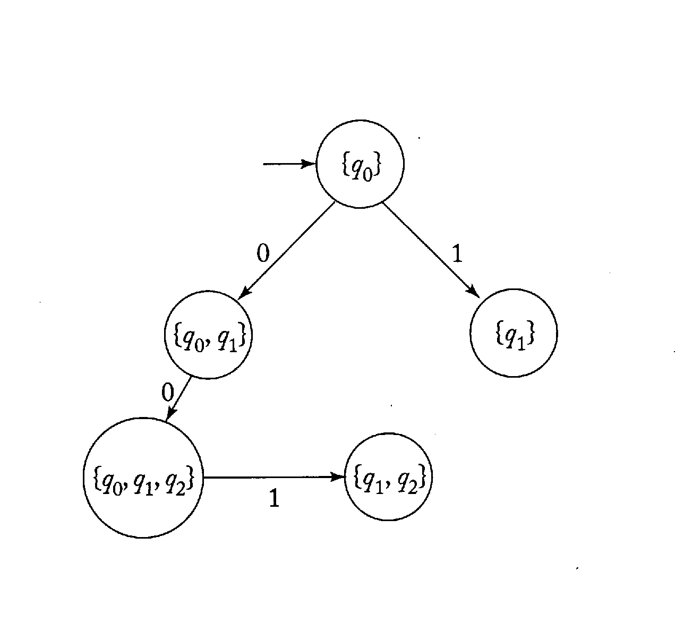
NDFA → DFA
Example:

Slide 61
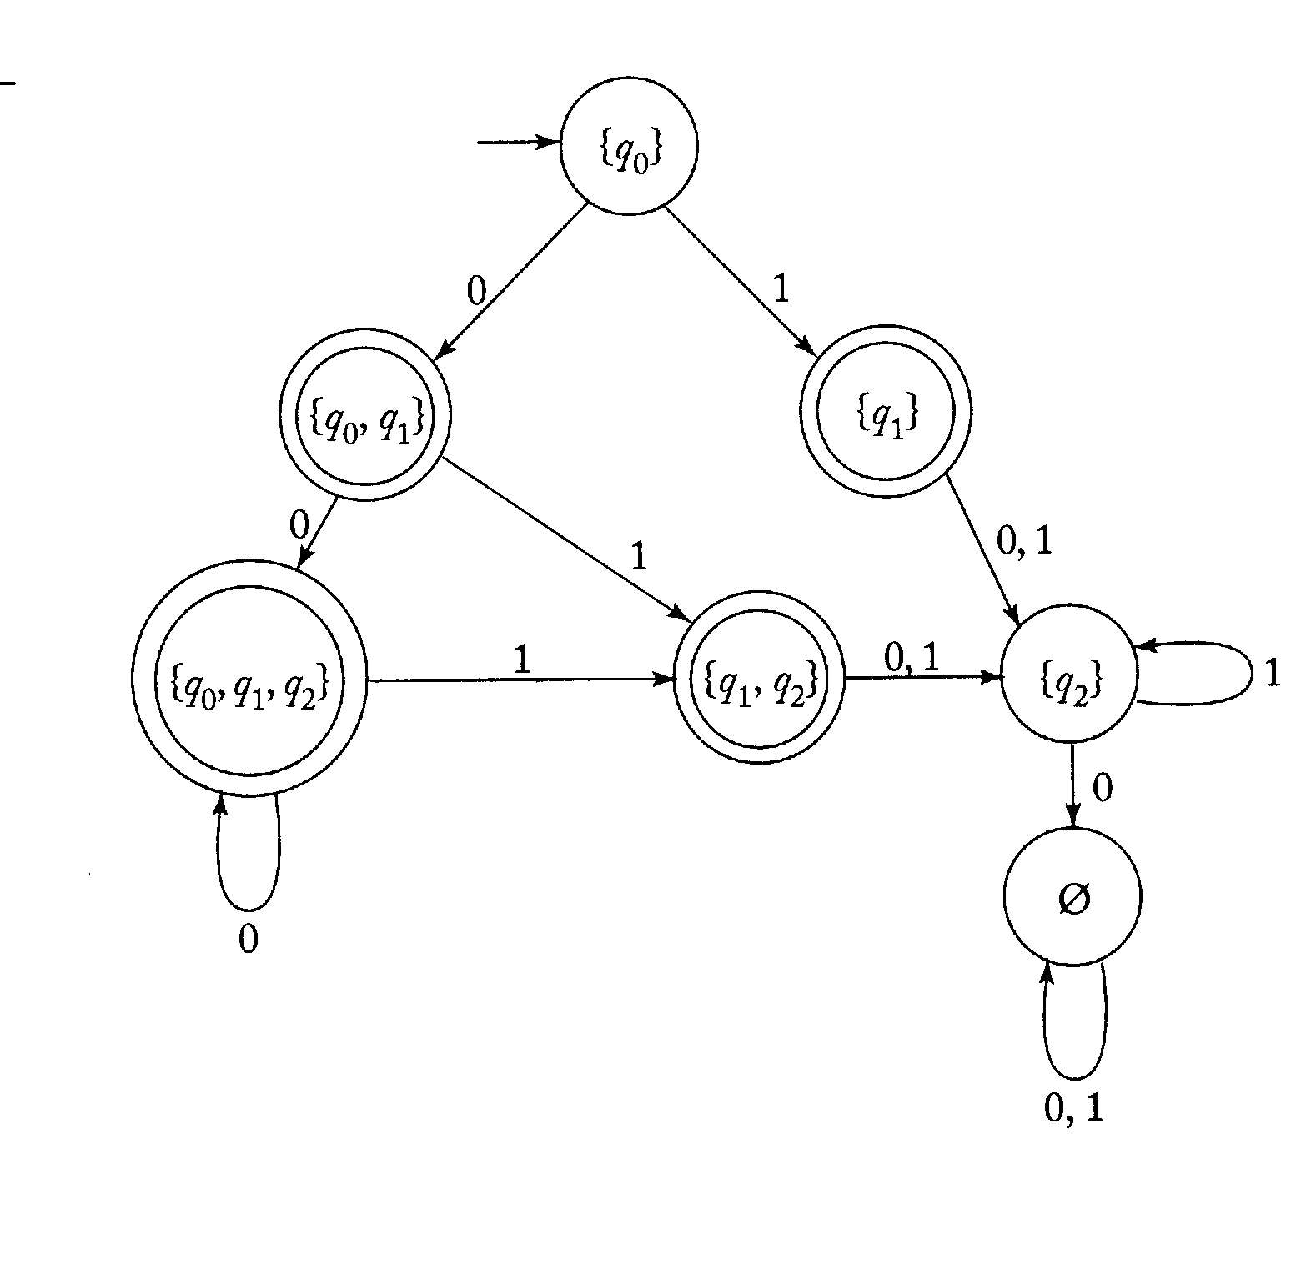
NDFA → DFA
Example:

Slide 62
Minimal DFA’s
Two states p and q of a DFA are called indistinguishable if
δ* (p, w) ∈ F implies δ* (q, w) ∈ F ,
and
δ* (p, w) ∉ F implies δ* (q, w) ∉ F ,
for all w ∈ Σ*.
If there exists some string w ∈ Σ* such that
δ* (p, w) ∈ F
and
δ* (q, w) ∉ F
or vice versa, then the states p and q are said to be distinguishable by string w.

Slide 63
The “Mark” procedure
This procedure marks all pairs of distinguishable states.
1. Remove all inaccessible states.
2. Consider all pairs of states (p, q). If p ∈ F and q ∉ F or vice versa, mark the pair (p, q) as distinguishable.
3. Repeat the following step until no previously unmarked pairs are marked:
For all pairs (p, q) and all a ∈ Σ, compute δ (p, a) = p_{a} and δ (q, a) = q_{a}. If the pair (p_{a}, q_{a}) is marked as distinguishable, mark (p, q) as distinguishable.

Slide 64
The “Reduce” procedure
Given a DFA M = (Q, Σ, δ, q₀, F), we construct a reduced DFA M’ = (Q’, Σ, δ’, q₀’, F’) as follows:
1. Use procedure Mark to find all pairs of distinguishable states. Then from this find the sets of indistinguishable states by partitioning the state set Q of the DFA into disjoint subsets {q_{i}, q_{j}, …, q_{k}}, {q_{l}, q_{m}, …, q_{n}}, …, such that any q ∈ Q occurs in exactly one of these subsets, that elements in each subset are indistinguishable, and that any two elements from different subsets are distinguishable.

Slide 65
The “Reduce” procedure, cont.
2. For each set {q_{i}, q_{j}, …, q_{k}} of such indistinguishable states, create a state labeled ij…k for M.
3. For each transition rule of the form δ (q_{r}, a) = q_{p}, find the sets to which q_{r} and q_{p} belong. If q_{r} ∈ {q_{i}, q_{j}, …, q_{k}} and q_{p} ∈ {q_{l}, q_{m}, …, q_{n}}, add to δ’ a rule δ’ (ij…k, a) = lm…n.
4. The initial state q₀’ is that state of M’ whose label includes the 0.
5. F’ is the set of all the states whose label contains i such that q_{i} ∈ F.

Slide 66
Theorem 2.4
Given any DFA M, application of the procedure Reduce yields another DFA M’ such that
L(M) = L(M’)
Furthermore, M’ is minimal in the sense that there is no other DFA with a smaller number of states which also accepts L(M).

Slide 67
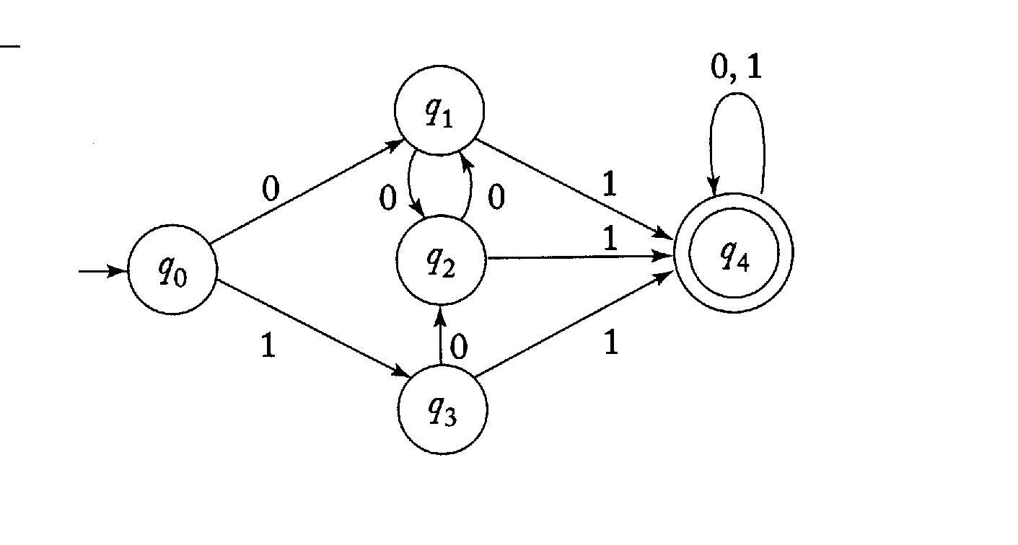
Minimal DFA’s
Example: This DFA can be reduced to the DFA on the next slide.

Slide 68
Minimal DFA’s
What are the distinguishable pairs?
Mark step 2 gives (q₀, q₄), (q₁, q₄), (q₂, q₄) and (q₃, q₄).
Step 3 computes δ(q₁, 1) = q₄ and δ(q₀, 1) = q₃. Since (q₃, q₄) is a distinguishable pair, (q₀, q₁) is also marked as a distinguishable pair. Eventually the pairs (q₀, q₁), (q₀, q₂), (q₀, q₃), (q₀, q₄), (q₁, q₄), (q₂, q₄) and (q₃, q₄) are marked as distinguishable.
The remaining pairs, (q₁, q₂), (q₁, q₃), and (q₂, q₃) are undistinguishable.
The states are partitioned into the sets {q₀}, {q₁, q₂, q₃}, and {q₄}.

Slide 69
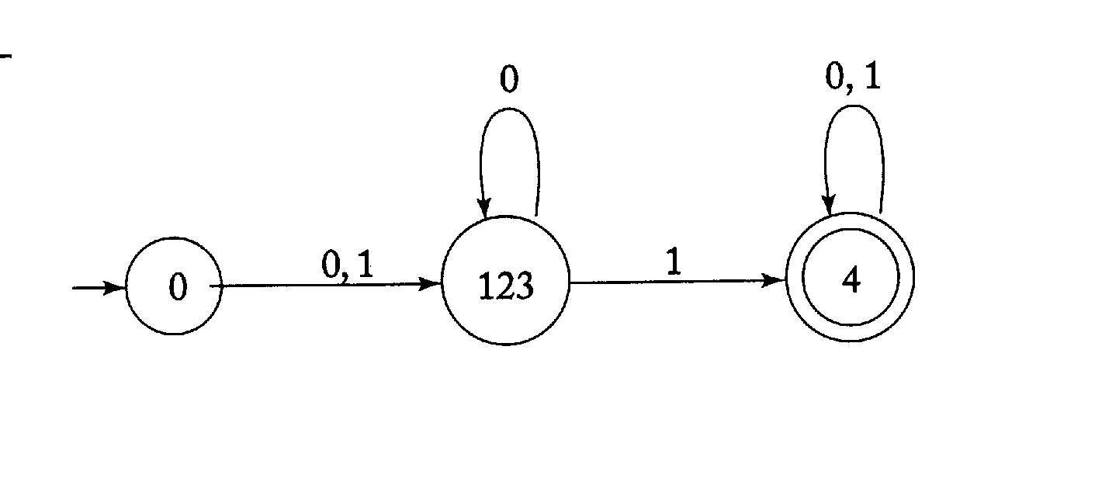
Minimal DFA’s
This is the reduced DFA resulting from the procedure.

Slide 70
Minimum number of states in an FA
If there are n distinguishable strings in a language, then there must be at least n states in the finite automata that accepts it.
The FA has no memory, other than the current state.
This puts a lower bound on the number of states in a FA recognizing a language.

Slide 71
Next chapter
Read chapter 3, Regular languages and regular grammars

